Slide 1
Crop-Aware Panoptic Segmentation
Mehdi Naouar, Ben Bausch, Yannick Vogt

Slide 2
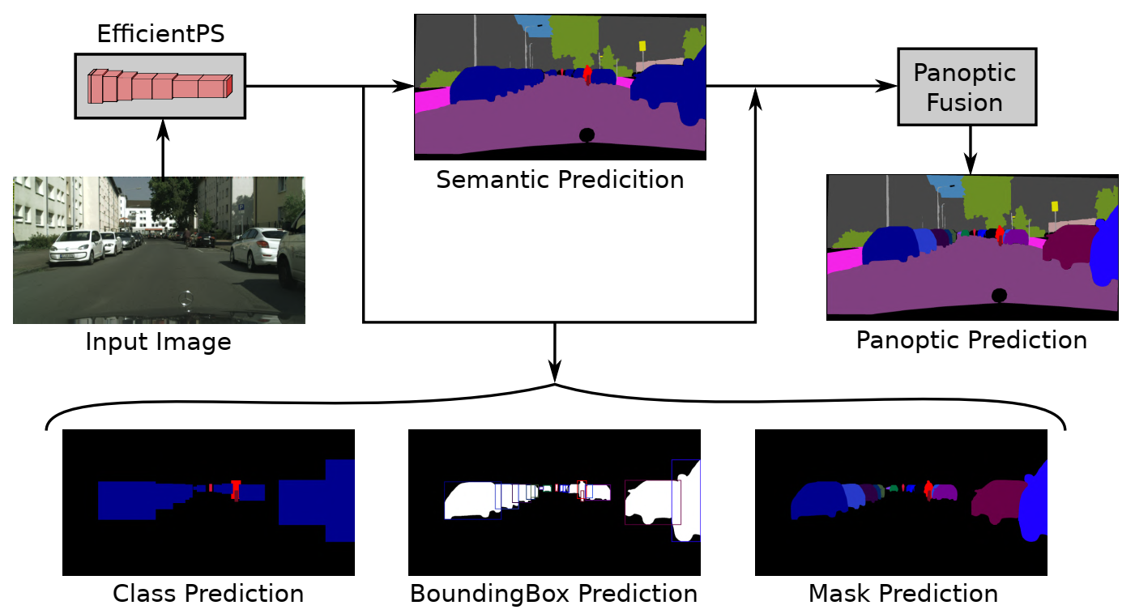
Panoptic Segmentation
[1]
Notes:
What is Panoptic Segmentation?
Whats the goal?
Rohits Paper

Slide 3

Bounding Box Prediction
Region Proposal Network proposes anchor boxes
Fully Connect Layer regresses transformations applied to the anchor to fit the ground truth Bounding Box
Smooth-L1 Loss

Slide 4
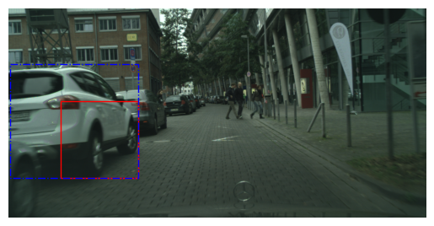
Bounding Box Example
Ground Truth, Anchor Box

Slide 5
Motivation
Full-size images consume too much memory
Resized images can’t represent fine structures
Idea: Train on crops

Slide 6
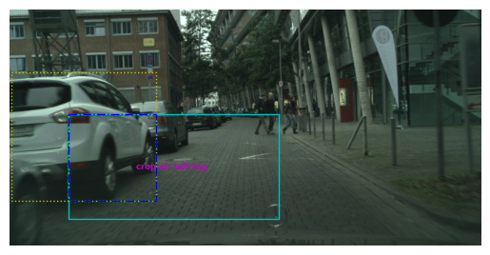
Crop Based Training
Allows training of larger networks or higher batch size
Fine structures can be preserved
Large objects might be truncated

Slide 7
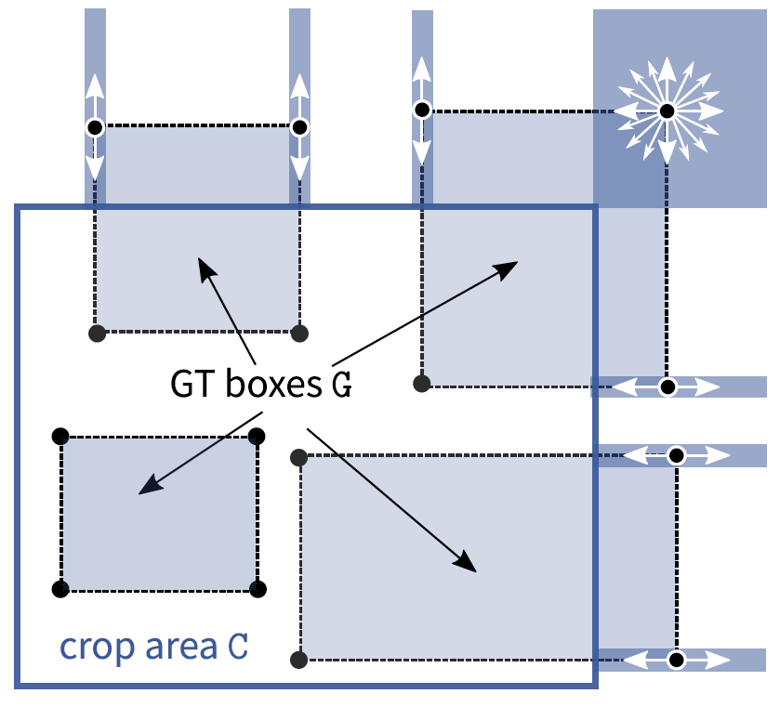
Crop-Aware Bounding Boxes (CABB)
Network is allowed to “hallucinate”
Can improve performance on objects which were cropped in training
[2]
Notes:
Explain cases
only outside can be modified

Slide 8
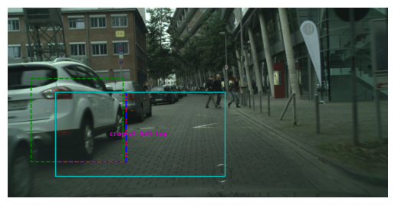
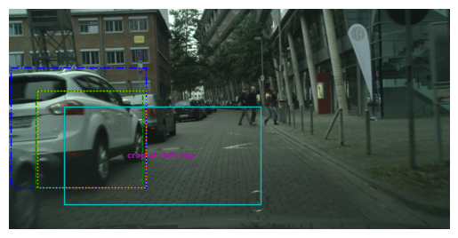
Visualization of CABB
Without CABB
With CABB
Ground Truth, Prediction, Crop Area, Anchor Box, CABB Target
Notes:
TODO add loss values here
With CABB is an adapted version is a greater equal in SOLVE O1
Left ground truth is cropped
We save the original gt
Right side we optimize a new target that minimizes loss based on cases
Explain colors

Slide 9
Dataset
Cityscapes Dataset
2975 training samples
500 validation samples
1525 test samples without ground truth

Slide 10
Training Setting
1024*512 Image size, 512*256 Crop size
100 epochs of training with 2975 training images
8 Image per Batch on a single GPU
~37.200 iterations

Slide 11
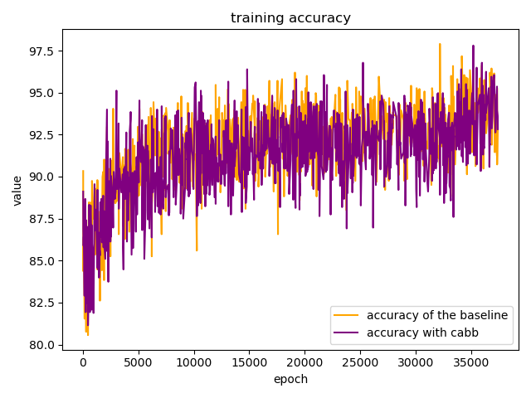
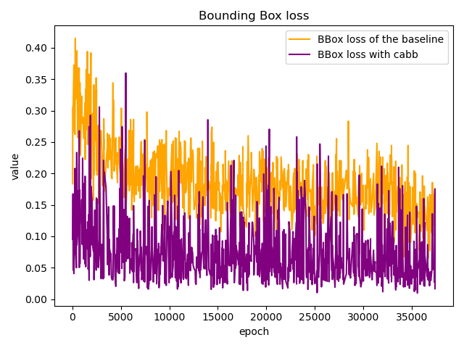
Training Results
39.5h for baseline vs 20.75h for the baseline

Slide 12
Validation Results
Validate models at epoch 100 on 500 full-sized images
Base | PQ | SQ | RQ | N
All | 47.6 | 75.5 | 60.9 | 19
Things | 42.0 | 75.1 | 55.8 | 8
Stuff | 51.7 | 75.8 | 64.5 | 11
CABB | PQ | SQ | RQ | N
All | 46.1 | 74.9 | 59.2 | 19
Things | 38.2 | 72.7 | 52.1 | 8
Stuff | 51.9 | 76.5 | 64.4 | 11

Slide 13
Conclusion

Slide 14
References
[1] Rohit Mohan, Abhinav Valada. EfficientPS: Efficient Panoptic Segmentation. arXiv:2004.02307v3, 2021
[2] Lorenzo Porzi, Samuel Rota Bulò, Peter Kontschieder. Improving Panoptic Segmentation at All Scales. arXiv:2012.07717v2, 2021

Slide 15
Thank you for your attention!

